Slide 1
Welcome!
Sunday
Bible Study 9:30 AM
Worship 10:30 AM
PM Bible Class (Livestream) 5:00 PM
Wednesday
Bible Class 7:00 PM
www.SunsetchurchofChrist.net

Slide 2
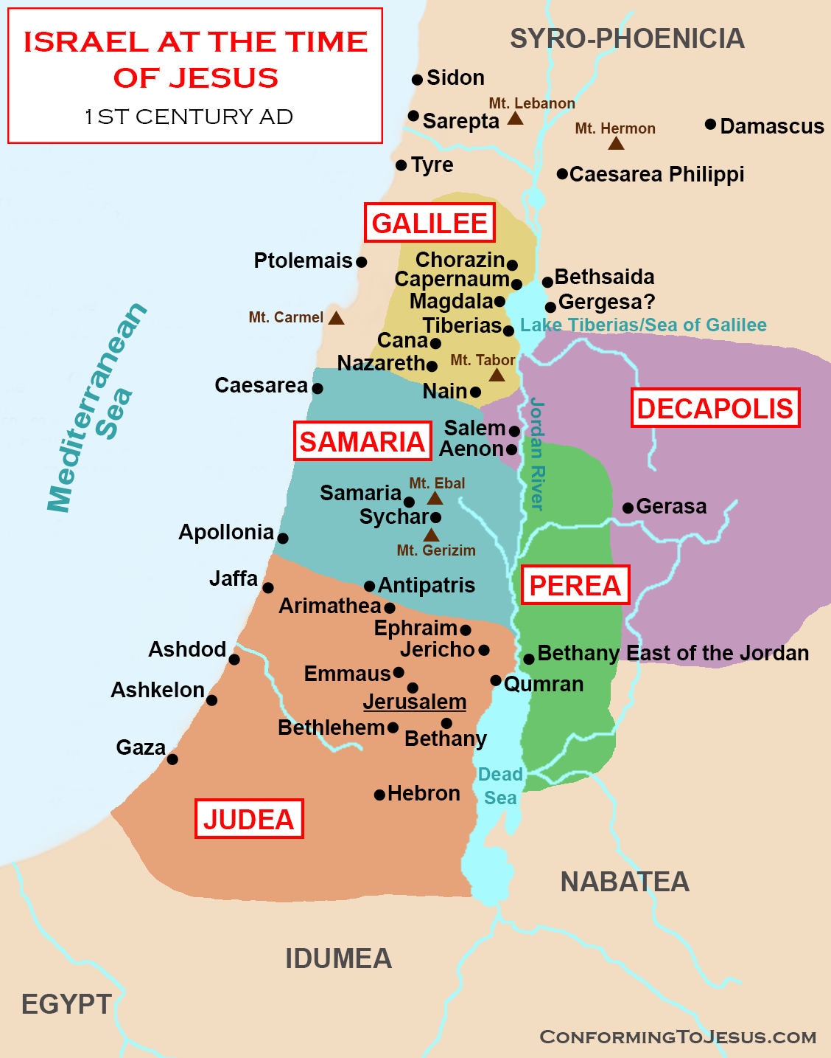
Notes:
Map taken with permission from https://www.conformingtojesus.com/images/webpages/israel_at_the_time_of_jesus_christ_1.png
Terms https://www.conformingtojesus.com/terms-conditions.htm

Slide 3
John 4:7-14
The Samaritan Woman
Jesus and the Living Water
John 7:37-39

Slide 4
John 4:15-24
The Samaritan Woman
Her marriage(s)
Jesus as a prophet
The place of worship
Salvation (knowledge) is of the Jews

Slide 5
John 4:15-24
Worship in Spirit and Truth

Slide 6
SPIRIT
Testimony of the Spirit – 1:32-33, 15:26
Born of the Spirit – 3:5
God is Spirit – 4:24
Worship must be in Spirit – 4:24
The Words of Jesus are Spirit – 6:63
The Water of Life is the Spirit – 7:39
The Spirit is Truth –14:17, 15:26, 16:13

Slide 7
TRUTH
Truth comes through Jesus – 1:17
Worship must be in truth – 4:24
Knowledge of the truth sets free – 8:32
Jesus is the truth – 14:6
The Spirit is truth – 14:17, 15:26, 16:13
The Word is truth – 17:17
We are of truth if we hear him – 18:37

Slide 8
John 4:15-24
Worship in Spirit and Truth
Spirit: John 6:63, 1 Cor. 2:12-16
Truth: John 17:17
Differences between worship then and now?

Slide 9
John 4:25-30
Knowledge of the Messiah
The conclusion of the confrontation

Slide 10
John 4:31-38
Jesus and the food of God
“The fields are white for harvest”

Slide 11
John 4:39-44
The conclusion of the Samaritan interaction
Contrasted with Galilee

Slide 12
Welcome!
Sunday
Bible Study 9:30 AM
Worship 10:30 AM
PM Bible Class (Livestream) 5:00 PM
Wednesday
Bible Class 7:00 PM
www.SunsetchurchofChrist.net

Slide 13
Opening Prayer | Anthony Ward
Song – 35 | Grant Haines
Scripture Reading | Michael Hetzer
Song – 636 | Grant Haines
Song – 175 | Grant Haines
Lord’s Supper | Michael Hetzer
Song – 350 | Grant Haines
Collection | Michael Hetzer
Song – 9 | Grant Haines
Lesson | Brian Haines
Song – 325 | Grant Haines
Closing | Ryan Sollars

Slide 14
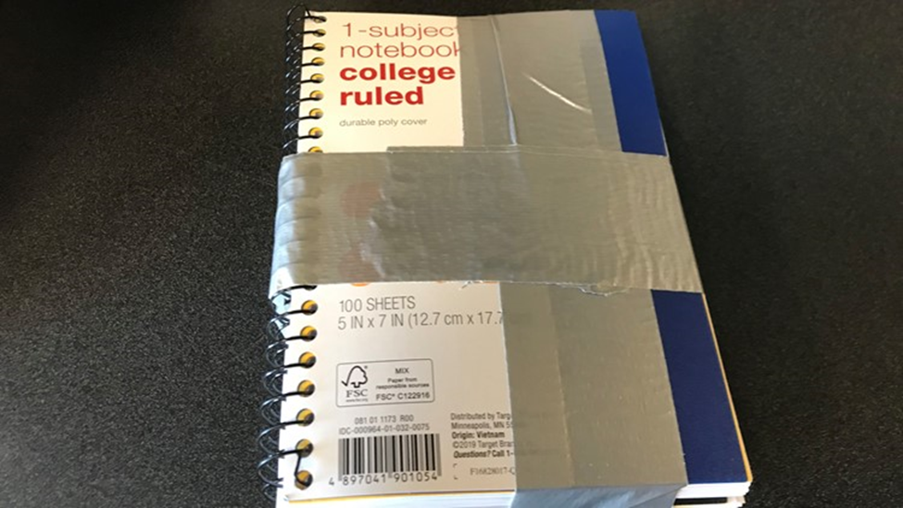
Local Man Nearly Loses $15k in Lottery Scam
Notes:
August 2019
RALEIGH HILLS, Ore. — An 83-year-old Raleigh Hills man recently almost lost $15,000 in a common scam.
The man had fallen victim to the “lottery scam,” according to the Washington County Sheriff's Office. Someone told the man he won a lottery, but he needed to pay a percentage of the winnings in order to have the money delivered.
Initially, the man sent scammers a bank check for $25,000 but the bank caught it and rejected it. Scammers then convinced the man to mail the money. He was instructed to conceal $15,000 worth of $100 bills between pages of notebooks, which were then taped together and sealed inside a shipping box, deputies said.

Slide 15
Defrauded!
Fraud
Fake agency
Fake family member
Fake interest
Notes:
Pretneding to be IRS or FBI or SS
Grandson in prison overseas
Wants to buy what I am selling

Slide 16
Defrauded!
Easy money
Too good to be true
Fear of missing out
Notes:
https://theconversation.com/five-psychological-reasons-why-people-fall-for-scams-and-how-to-avoid-them-102421

Slide 17
Defrauded!
Easy money
Fear
Exploiting ignorance
Threatening
Notes:
https://theconversation.com/five-psychological-reasons-why-people-fall-for-scams-and-how-to-avoid-them-102421

Slide 18
Defrauded!
Easy money
Fear
Bad trust
Appeal to emotions
Everyone is doing it
Notes:
https://theconversation.com/five-psychological-reasons-why-people-fall-for-scams-and-how-to-avoid-them-102421

Slide 19
Defrauded!
People are cheated by:
Greed
Pride
Fear
Notes:
https://theconversation.com/five-psychological-reasons-why-people-fall-for-scams-and-how-to-avoid-them-102421

Slide 20
Spiritual Fraud Alerts
Fraud Alert #1 – False teachers
Let no one deceive you with empty words, for because of these things the wrath of God comes upon the sons of disobedience. Ephesians 5:6
Notes:
Eph 5:5 For this you know, that no fornicator, unclean person, nor covetous man, who is an idolater, has any inheritance in the kingdom of Christ and God. 6 Let no one deceive you with empty words, for because of these things the wrath of God comes upon the sons of disobedience. 7 Therefore do not be partakers with them.

Slide 21
Spiritual Fraud Alerts
Fraud Alert #1 – False teachers
Now this I say lest anyone should deceive you with persuasive words. Colossians 2:4
Notes:
Eph 5:5 For this you know, that no fornicator, unclean person, nor covetous man, who is an idolater, has any inheritance in the kingdom of Christ and God. 6 Let no one deceive you with empty words, for because of these things the wrath of God comes upon the sons of disobedience. 7 Therefore do not be partakers with them.

Slide 22
Spiritual Fraud Alerts
Fraud Alert #1 – False teachers
For those who are such do not serve our Lord Jesus Christ, but their own belly, and by smooth words and flattering speech deceive the hearts of the simple. Romans 16:18
Notes:
Eph 5:5 For this you know, that no fornicator, unclean person, nor covetous man, who is an idolater, has any inheritance in the kingdom of Christ and God. 6 Let no one deceive you with empty words, for because of these things the wrath of God comes upon the sons of disobedience. 7 Therefore do not be partakers with them.

Slide 23
Spiritual Fraud Alerts
Fraud Alert #1 – False teachers
“Easy money”
Telling you it is okay to be disobedient
Telling you God won’t punish sin
Telling you rule keeping is unnecessary
Notes:
Eph 5:5 For this you know, that no fornicator, unclean person, nor covetous man, who is an idolater, has any inheritance in the kingdom of Christ and God. 6 Let no one deceive you with empty words, for because of these things the wrath of God comes upon the sons of disobedience. 7 Therefore do not be partakers with them.

Slide 24
Spiritual Fraud Alerts
Fraud Alert #1 – False teachers
How can you be safe?
Beloved, do not believe every spirit, but test the spirits, whether they are of God; because many false prophets have gone out into the world. 1 John 4:1
Notes:
Eph 5:5 For this you know, that no fornicator, unclean person, nor covetous man, who is an idolater, has any inheritance in the kingdom of Christ and God. 6 Let no one deceive you with empty words, for because of these things the wrath of God comes upon the sons of disobedience. 7 Therefore do not be partakers with them.

Slide 25
Spiritual Fraud Alerts
Fraud Alert #2 – False doctrines and doubt
Let no one in any way deceive you, for it will not come unless the apostasy comes first, and the man of lawlessness is revealed, the son of destruction, 2 Thessalonians 2:3
Notes:
Eph 5:5 For this you know, that no fornicator, unclean person, nor covetous man, who is an idolater, has any inheritance in the kingdom of Christ and God. 6 Let no one deceive you with empty words, for because of these things the wrath of God comes upon the sons of disobedience. 7 Therefore do not be partakers with them.

Slide 26
Spiritual Fraud Alerts
Fraud Alert #2 – False doctrines and doubt
Now the Spirit expressly says that in latter times some will depart from the faith, giving heed to deceiving spirits and doctrines of demons, 1 Timothy 4:1
Notes:
Eph 5:5 For this you know, that no fornicator, unclean person, nor covetous man, who is an idolater, has any inheritance in the kingdom of Christ and God. 6 Let no one deceive you with empty words, for because of these things the wrath of God comes upon the sons of disobedience. 7 Therefore do not be partakers with them.

Slide 27
Spiritual Fraud Alerts
Fraud Alert #2 – False doctrines
False trust
Confusing you with half-truths
Deceiving you with meaningless ideas
Scaring you with false confidence
Seeing everyone believe in it
Notes:
Eph 5:5 For this you know, that no fornicator, unclean person, nor covetous man, who is an idolater, has any inheritance in the kingdom of Christ and God. 6 Let no one deceive you with empty words, for because of these things the wrath of God comes upon the sons of disobedience. 7 Therefore do not be partakers with them.

Slide 28
Spiritual Fraud Alerts
Fraud Alert #2 – False doctrines
How can you be safe?
Test all things; hold fast what is good. Abstain from every form of evil. 1 Thessalonians 5:21-22
Notes:
Eph 5:5 For this you know, that no fornicator, unclean person, nor covetous man, who is an idolater, has any inheritance in the kingdom of Christ and God. 6 Let no one deceive you with empty words, for because of these things the wrath of God comes upon the sons of disobedience. 7 Therefore do not be partakers with them.

Slide 29
Spiritual Fraud Alerts
Fraud Alert #3 – Appeal to emotion
Let no one keep defrauding you of your prize by delighting in self-abasement and the worship of the angels, taking his stand on visions he has seen, inflated without cause by his fleshly mind Colossians 2:18
Notes:
Eph 5:5 For this you know, that no fornicator, unclean person, nor covetous man, who is an idolater, has any inheritance in the kingdom of Christ and God. 6 Let no one deceive you with empty words, for because of these things the wrath of God comes upon the sons of disobedience. 7 Therefore do not be partakers with them.

Slide 30
Spiritual Fraud Alerts
Fraud Alert #3 – Appeal to emotion
Indeed they are prophets of the deceit of their own heart Jeremiah 23:26
The heart is more deceitful than all else…. Jeremiah 17:9
Notes:
Eph 5:5 For this you know, that no fornicator, unclean person, nor covetous man, who is an idolater, has any inheritance in the kingdom of Christ and God. 6 Let no one deceive you with empty words, for because of these things the wrath of God comes upon the sons of disobedience. 7 Therefore do not be partakers with them.

Slide 31
Spiritual Fraud Alerts
Fraud Alert #3 – Appeal to emotion
Playing on emotions
Making choices based on feelings
Choosing what seems right
Notes:
Eph 5:5 For this you know, that no fornicator, unclean person, nor covetous man, who is an idolater, has any inheritance in the kingdom of Christ and God. 6 Let no one deceive you with empty words, for because of these things the wrath of God comes upon the sons of disobedience. 7 Therefore do not be partakers with them.

Slide 32
Spiritual Fraud Alerts
Fraud Alert #3 – Appeal to emotion
How can you be safe?
Trust in the LORD with all your heart, and do not lean on your own understanding. Proverbs 3:5
Notes:
Eph 5:5 For this you know, that no fornicator, unclean person, nor covetous man, who is an idolater, has any inheritance in the kingdom of Christ and God. 6 Let no one deceive you with empty words, for because of these things the wrath of God comes upon the sons of disobedience. 7 Therefore do not be partakers with them.

Slide 33
Spiritual Fraud Alerts
Fraud Alert #3 – Appeal to emotion
How can you be safe?
So then faith comes by hearing, and hearing by the word of God. Romans 10:17
Notes:
Eph 5:5 For this you know, that no fornicator, unclean person, nor covetous man, who is an idolater, has any inheritance in the kingdom of Christ and God. 6 Let no one deceive you with empty words, for because of these things the wrath of God comes upon the sons of disobedience. 7 Therefore do not be partakers with them.

Slide 34
Notes:
https://babylonbee.com/news/progressive-christian-offers-new-more-open-less-judgmental-christianity--no-wait-its-just-satan-again?fbclid=IwAR1UTCbZQBLb8IHkAPpNNWzOdDDEFmCFqf1ei_C7-1qyvCjdPNHHTeRe3Ak,
Imag from https://en.wikipedia.org/wiki/The_Babylon_Bee

Slide 35
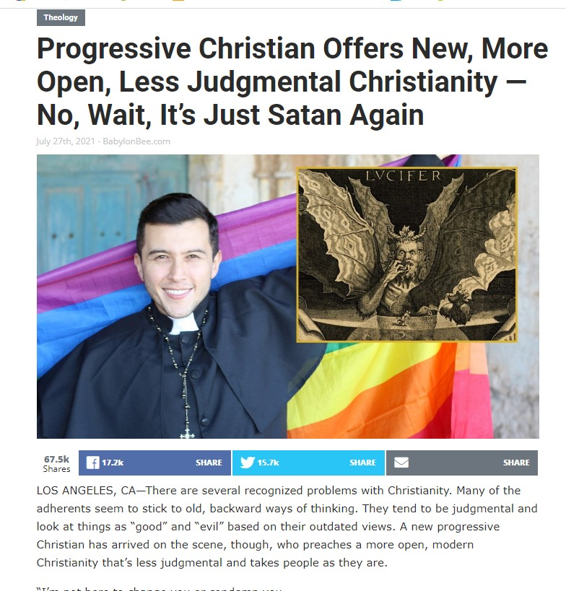
Notes:
https://babylonbee.com/news/progressive-christian-offers-new-more-open-less-judgmental-christianity--no-wait-its-just-satan-again?fbclid=IwAR1UTCbZQBLb8IHkAPpNNWzOdDDEFmCFqf1ei_C7-1qyvCjdPNHHTeRe3Ak,
Imag from https://en.wikipedia.org/wiki/The_Babylon_Bee

Slide 36
“Yeah, almost had you this time,” said Satan. “I just keep packaging up sin and self-worship as a virtue, but people like that, you know.”
Notes:
https://babylonbee.com/news/progressive-christian-offers-new-more-open-less-judgmental-christianity--no-wait-its-just-satan-again?fbclid=IwAR1UTCbZQBLb8IHkAPpNNWzOdDDEFmCFqf1ei_C7-1qyvCjdPNHHTeRe3Ak,
Imag from https://en.wikipedia.org/wiki/The_Babylon_Bee

Slide 37
The Constant Admonition
“Do not be deceived”
Galatians 6:7
1 Corinthians 15:33
1 Corinthians 6:9
Notes:
Galatians 6:7 Do not be deceived, God is not mocked; for whatever a man sows, that he will also reap.
1 Corinthians 15:33 Do not be deceived: "Evil company corrupts good habits."
1 Corinthians 6:9 Do you not know that the unrighteous will not inherit the kingdom of God? Do not be deceived. Neither fornicators, nor idolaters, nor adulterers, nor homosexuals, nor sodomites, nor thieves, nor [the] covetous, nor drunkards, nor revilers, nor swindlers, shall inherit the kingdom of God.

Slide 38
The Constant Admonition
“Do not be deceived”
But I fear, lest somehow, as the serpent deceived Eve by his craftiness, so your minds may be corrupted from the simplicity that is in Christ. 2 Corinthians 11:3
Notes:
Galatians 6:7 Do not be deceived, God is not mocked; for whatever a man sows, that he will also reap.
1 Corinthians 15:33 Do not be deceived: "Evil company corrupts good habits."
1 Corinthians 6:9 Do you not know that the unrighteous will not inherit the kingdom of God? Do not be deceived. Neither fornicators, nor idolaters, nor adulterers, nor homosexuals, nor sodomites, nor thieves, nor [the] covetous, nor drunkards, nor revilers, nor swindlers, shall inherit the kingdom of God.

Slide 40
The Simplicity That is in Christ
Hearing and believing – John 5:24
Sin cuts us off from God
God has prepared a way to save you
“God does not take away a life; but He devises means, so that His banished ones are not expelled from Him” 2 Samuel 14:14
Notes:
Galatians 6:7 Do not be deceived, God is not mocked; for whatever a man sows, that he will also reap.
1 Corinthians 15:33 Do not be deceived: "Evil company corrupts good habits."
1 Corinthians 6:9 Do you not know that the unrighteous will not inherit the kingdom of God? Do not be deceived. Neither fornicators, nor idolaters, nor adulterers, nor homosexuals, nor sodomites, nor thieves, nor [the] covetous, nor drunkards, nor revilers, nor swindlers, shall inherit the kingdom of God.

Slide 41
The Simplicity That is in Christ
Hearing and believing – John 5:24
Confession Jesus as Lord – Romans 10:9
Confession means taking sides
He answered and said, "I believe that Jesus Christ is the Son of God.“ Acts 8:37
Notes:
Galatians 6:7 Do not be deceived, God is not mocked; for whatever a man sows, that he will also reap.
1 Corinthians 15:33 Do not be deceived: "Evil company corrupts good habits."
1 Corinthians 6:9 Do you not know that the unrighteous will not inherit the kingdom of God? Do not be deceived. Neither fornicators, nor idolaters, nor adulterers, nor homosexuals, nor sodomites, nor thieves, nor [the] covetous, nor drunkards, nor revilers, nor swindlers, shall inherit the kingdom of God.

Slide 42
The Simplicity That is in Christ
Hearing and believing – John 5:24
Confession Jesus as Lord – Romans 10:9
Repentance from sin – Acts 2:38
Choosing God over sin
"No one can serve two masters” Matthew 6:24
Notes:
Galatians 6:7 Do not be deceived, God is not mocked; for whatever a man sows, that he will also reap.
1 Corinthians 15:33 Do not be deceived: "Evil company corrupts good habits."
1 Corinthians 6:9 Do you not know that the unrighteous will not inherit the kingdom of God? Do not be deceived. Neither fornicators, nor idolaters, nor adulterers, nor homosexuals, nor sodomites, nor thieves, nor [the] covetous, nor drunkards, nor revilers, nor swindlers, shall inherit the kingdom of God.

Slide 43
The Simplicity That is in Christ
Hearing and believing – John 5:24
Confession Jesus as Lord – Romans 10:9
Repentance from sin – Acts 2:38
Baptism: being born again – Acts 22:16
Jesus answered, "Most assuredly, I say to you, unless one is born of water and the Spirit, he cannot enter the kingdom of God. John 3:5
Notes:
Galatians 6:7 Do not be deceived, God is not mocked; for whatever a man sows, that he will also reap.
1 Corinthians 15:33 Do not be deceived: "Evil company corrupts good habits."
1 Corinthians 6:9 Do you not know that the unrighteous will not inherit the kingdom of God? Do not be deceived. Neither fornicators, nor idolaters, nor adulterers, nor homosexuals, nor sodomites, nor thieves, nor [the] covetous, nor drunkards, nor revilers, nor swindlers, shall inherit the kingdom of God.

